Slide 1
ISO 17020:2012 Management Systems for CMMC Certification Bodies

Slide 2
Basic Overview of ISO 17020 “Note: Substitute Inspection with Assessment to facilitate a better understanding of the Standard”
Notes:
This overview reviews the history and intent of ISO 17020

Slide 3
Why ISO 17020?
The model for the Accreditation body (CMMC-AB) and Conformity Assessment Body (C3PAO) is mandated by the Department of War.
CMMC-AB is an Accreditation Body and the C3PAO’s are accredited by CMMC-AB to be compliant to ISO 17020 requirements.
ISO 17020 defines the requirements for the operations for companies that perform conduct assessments (inspections) Title: ISO 17020: 2012 Conformity assessment-Requirements for the operation of various types of bodies performing inspection
Notes:
ISO 17020 accreditation was mandated by the Department of Defense in order to ensure that certification bodies conduct CMMC certification assessments, in a competent, consistent and impartial manner.
CMMC-AB is accredited to ISO 17011 accreditor requirements prior to beginning C3PAO accreditation. The accreditation body must have similar documents and evidence of implementing ISO 17011. They are accredited by a peer review.
C3PAO’s (Certified Bodies) are accredited by an accreditation body. In this case the CMMC-AB which was designated as such by the DoD.
Accreditation of an organization as a independent third-party inspection company, i.e. a Certified Body, to ISO 17020 provides assurance that the organization has implemented a system for the management of the relevant aspects of its activities as specified by ISO 17020 and meets customer expectations and needs.
Certification of a Department of Defense contractor by an accredited certified body provides evidence that the requirements specified in the Cybersecurity Maturity Model (CMMC) have been implemented to the specified Level and are being maintained.

Slide 4
ISO 17020 - What is it?
ISO 17020 was established with the objective of promoting confidence in bodies performing inspection to specified requirements.
Inspection bodies carry out assessments on behalf of private clients, their parent organizations, or authorities, with the objective of providing information about the conformity of inspected items with regulations, standards, specifications, inspection schemes (CMMC) or contracts.
Source: ISO 17020:2012 Introduction
Notes:
As with all of the ISO standards, a government entity identified an area or industry that presents a risk to the well being of the country, people, or environment and develops a standard to bring a chaotic situation into a structured manner in order to ensure consistent, impartial results.
Inconsistent inspection results from inspections conducted by various organizations forced the implementation of ISO 17020.
Inspection bodies carry out inspections or assessments on behalf of private clients, their parent organization of authorities such as the Department of Defense.
Inspections are performed against regulations, standards, specifications, contracts or inspection schemes such as CMMC.

Slide 5
ISO 17020 - What is it?
ISO 17020 specifies the generic requirements for the operation of various types of bodies performing inspections
ISO/IEC 17020 incorporates same level of requirements for the organizational management system as ISO 9001.
ISO/IEC 17020, however, puts greater emphasis on organizational ability to manage impartiality and conflicts of interest as well as the technical competence of people, inspection processes, and equipment.
Notes:
ISO 17020 specifies generic requirements and does not state how the requirements are to be implemented. Each accredited Certified Body is required to document the processes and procedures indicating how the requirements are to be met.
ISO 17020’s prime focus is on managing the inspection process, impartiality, conflicts of interest, and technical competence of people performing assessments.
A first review of the requirements can be very confusing if you are not familiar with the original intent of ISO 17020. The easiest way to better understand the requirements is substitute the word “inspection” with “assessment” and “inspector” with “assessor”.
Inspection parameters such as quantity, quality, safety, fitness for purpose, and continued safety compliance of installations or systems in operations are terms that really don’t correlate with the CMMC requirements.
There are specific requirements that do not apply to CMMC assessment activities. I will address them during the explanation of the Standard requirements.
C3PAO’s will strictly adhere to CMMC requirements and assessment procedures to ensure consistent results from all assessors across the ecosystem.

Slide 6
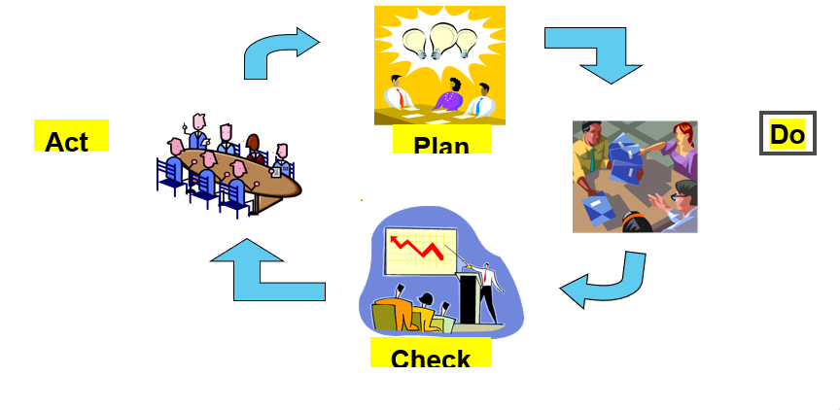
Operations Management System
The Operations Management System is modeled on the closed loop Business Management Process Model for Continual Improvement.
The focus is continual improvement to ensure an effective management system and improved bottom line.
Section 9
Section 4 - 6
Section 7
Section 9

Slide 7
Independence requirements for inspection bodies ISO 17020 Standard Annex A Type A, Type C Inspection Bodies
R2002 Cyber AB Accreditation Requirements Section 2 Definitions
Inspection Body Types. Annex A of ISO/IEC 17020:2012 provides the formal internationally accepted criteria of the three types of Inspection bodies. For the Cyber AB’s CMMC accreditation scheme, which only permits Type A and Type C inspection bodies, the specific interpretations of the three types of C3PAOs are as follows:
Notes:
The first section we are going to look at is the requirements for Independent Inspection Bodies. Section 4.1.6 of the standard specifies the requirements.

Slide 8
Type A Requirements
Provides a Conformity Assessment Body (C3PAO) with a structure to manage their business and improve operations.
There are 3 types of conformity assessment bodies defined in ISO 17020
Type A – Third Party Inspection (CMMC assessments)
Type B - 2nd Party Inspections by body with vested interest
Type C - 1st Party Inspections of parent company
Notes:
. There are three categories of “Inspection Bodies”.
Third Party inspection bodies
Second Party inspection bodies – vested interest
First Party inspection bodies - could be biased

Slide 9
Type A Requirements
A.1 Requirements for inspection bodies
The inspection body type is defined in paragraph 4.1.6 a): An inspection body providing third party inspections shall meet the type A requirements of Clause A.1 (third party inspection body).
a) The inspection body shall be independent of the parties involved.
Notes:
C3PAO’s are independent 3rd party inspection bodies which means they are required to met the requirements stated in Annex A, Type A. Third party means they have no bias or ownership to the outcome of the assessment.

Slide 10
Type A Requirements
a) The inspection body shall be independent of the parties involved.
b) The inspection body and its personnel shall not engage in any activities that may conflict with their independence of judgment and integrity in relation to their inspection activities. In particular, they shall not be engaged in the design, manufacture, supply, installation, purchase, ownership, use or maintenance of the items inspected.
NOTE 1 This does not preclude exchanging technical information between the client and the inspection body (e.g., explanation of findings or clarifying requirements or training).
NOTE 2 This does not preclude the purchase, ownership or use of inspected items that are necessary for the operations of the inspection body, or the purchase, ownership or use of the items for personal purposes by the personnel.
Notes:
The key words in this requirement are:
Independent
No activities that would conflict with independence of judgement
The sentence in gray is not applicable with the exception if you would be involved in the “design” of your clients Cybersecurity program.

Slide 11
Type A Requirements
An inspection body shall not be a part of a legal entity that is engaged in design, manufacture, supply, installation, purchase, ownership, use or maintenance of the items inspected except where there is:
1) common ownership, and the owners have no ability to influence the outcome of an inspection;
2) common ownership appointees on the boards or equivalent of the organizations, and these functions have no influence on the outcome of an inspection;
3) Individuals directly reporting to the same higher level of management, and they cannot influence the outcome of an inspection, and
4) There are no contractual commitments, or other means that may have an ability to influence the outcome of an inspection.
Notes:
This requirement is saying your organization cannot be legally part of or involved with an entity that was involved with the creation of the cybersecurity system being assessed.

Slide 12
Type C Requirements (ISO 17020)
A Type C C3PAO’s offer consulting services or managed services in addition to CMMC assessment services and cannot be considered a Type A Inspection Body.
The inspection body shall provide safeguards within the organization to ensure adequate segregation of responsibilities and accountabilities between inspection and other activities.
When providing ancillary services such as the design/ manufacture/ supply/ installation/ servicing/ maintenance and the inspection of the same item carried out by a Type C inspection body shall not be undertaken by the same person. An exception to this is where a regulatory requirement explicitly allows an individual person from a Type C inspection body to undertake both the design/manufacture/supply/installation/servicing/maintenance and the inspection of the same item, as long as this exception does not compromise the inspection results.
Notes:
. There are three categories of “Inspection Bodies”.
Third Party inspection bodies
Second Party inspection bodies – vested interest
First Party inspection bodies - could be biased

Slide 13
ISO 17020:2012 Two Document System Contains all Accreditation Requirement

Slide 14
Typical Project Timeline
1 Week
Kick-off Meeting
Gap Assessment
10 Weeks
Create Documents
Interview Process Owners
1 Week
Management Review
Certification
Compliance Audit
Collect Data

Slide 15
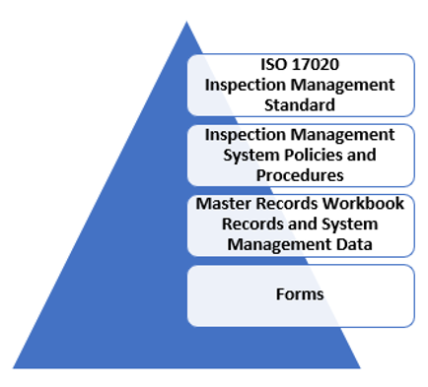
C3PAO Requirement Documents
Additional Cyber AB Accreditation Requirements
R1001
R2002
CMMC Assessment Process (CAP)

Slide 16
C3PAO Requirement Documents

Slide 17
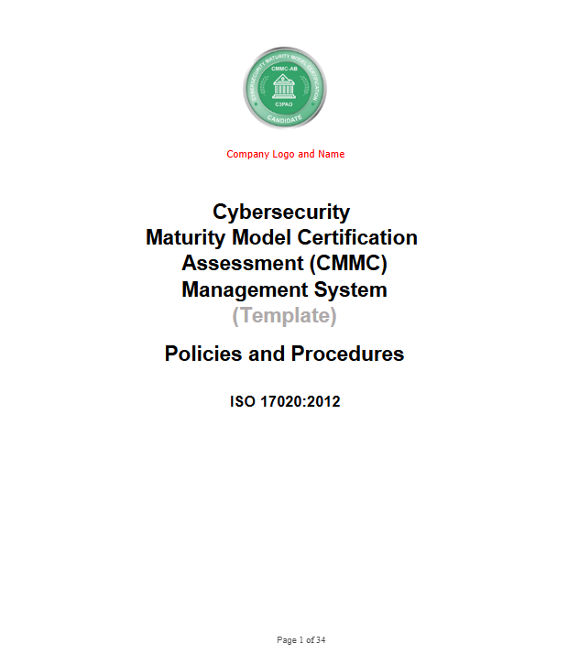
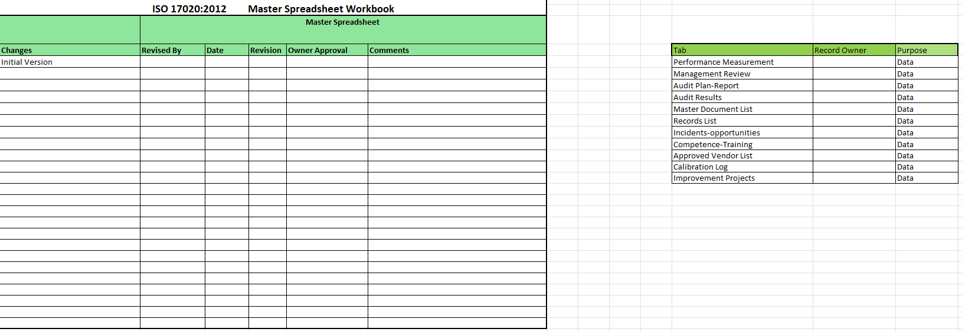
Two Document Integrated Management System
Management System Manual
Master Record-Forms Spreadsheet Workbook

Slide 18
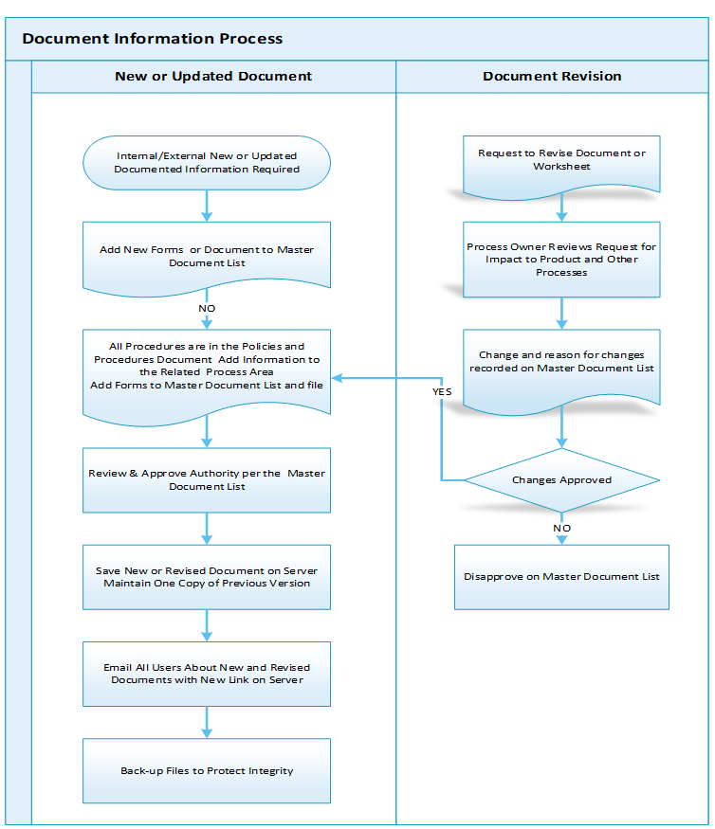
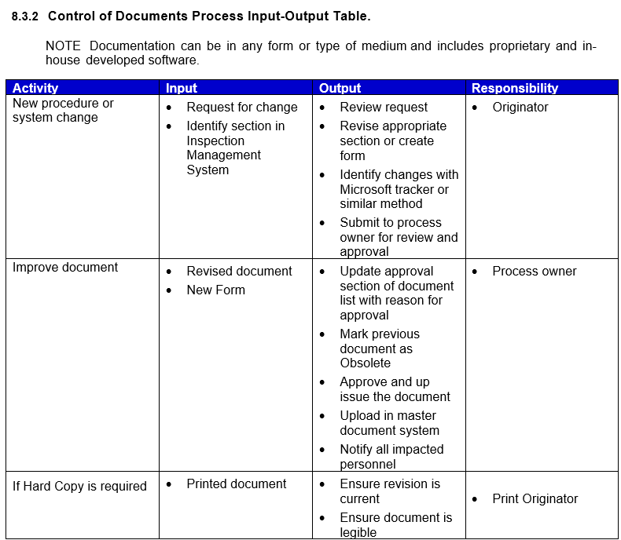
Management System Manual (IMS) Format
Flow Diagram
Inputs and Outputs

Slide 19
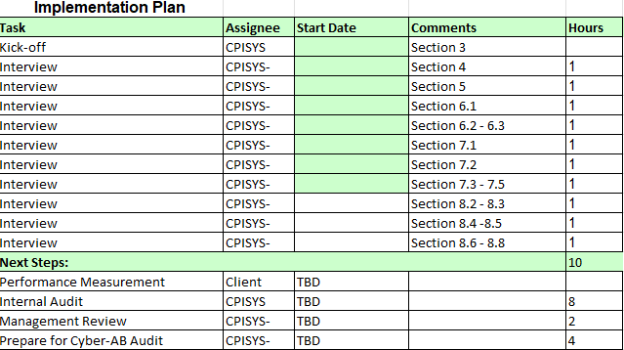
Implementation Plan

Slide 20
Accreditation Process
Cyber AB
(Accreditation Body)
DoW
CMMC
Certification Scheme
C3PAO
(Certification Body)
(CAB)
Organization
Seeking
Certification
(OSC)
Notes:
ISO 17020 accreditation was mandated by the Department of Defense in order to ensure that certification bodies conduct CMMC certification assessments, in a competent, consistent and impartial manner.
CMMC-AB is accredited to ISO 17011 accreditor requirements prior to beginning C3PAO accreditation. The accreditation body must have similar documents and evidence of implementing ISO 17011. They are accredited by a peer review.
C3PAO’s (Certified Bodies) are accredited by an accreditation body. In this case the CMMC-AB which was designated as such by the DoD.
Accreditation of an organization as a independent third-party inspection company, i.e. a Certified Body, to ISO 17020 provides assurance that the organization has implemented a system for the management of the relevant aspects of its activities as specified by ISO 17020 and meets customer expectations and needs.
Certification of a Department of Defense contractor by an accredited certified body provides evidence that the requirements specified in the Cybersecurity Maturity Model (CMMC) have been implemented to the specified Level and are being maintained.

Slide 21
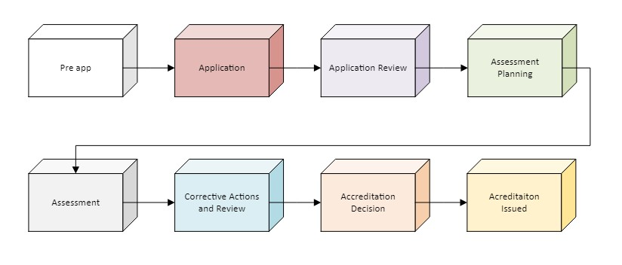
Accreditation Process

Slide 22
Interesting Things to Know
There are 160 shalls in ISO 17020:2012 - Requirements you must meet
The CMMC Assessment Process (CAP v2.0) document has 108 shalls
The ISO 17020 additional requirements in the Cyber AB R2002 has 79 additional shalls.
R1001 Cyber Ab Accreditation Manual has 24 musts
The management system must be in place for a minimum of 3 months (R1001, 5.2.1)
One nonconformity is a fail. You have 30 days to take corrective action and send back to Cyber AB

